Slide 1
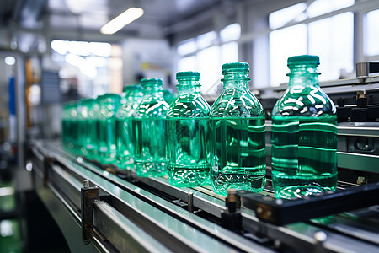

Topic & Overview Title: NLP for Quality Control Reports in Production Line Presented by: Teja Tadisetty Boshi Zhao Anandu Hari Guided by: Dr.Hamidreza Heidari Industrial Problem: Manual visual inspection of bottles on production lines is slow, error-prone, and unsafe at high conveyor speeds. Main Goal: Develop an AI-based system to automatically classify good vs defective bottles in real time, with explainable insights using NLP.

Slide 2
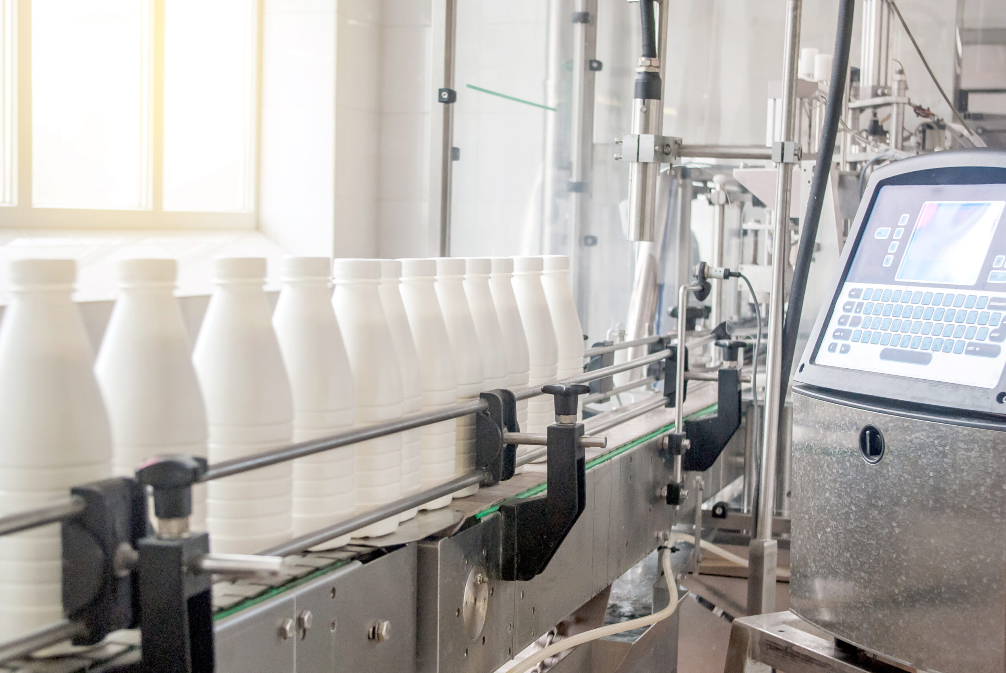
Input Parameters / Data
Input Sources:
Conveyor belt video footage (industrial environment)
Good bottle image dataset
Defective bottle dataset
Assumptions:
Bottles move in a fixed direction
Camera mounted above conveyor belt
Defects include shape, label, cap/water level Units / Ranges:
Frame size: 640×480
FPS: 25
Confidence score: 0–1
Bottle ID increments per frame
Data Collection:
Frame extraction from conveyor video
Open CV + Python to preprocess frames
CNN trained on labeled good/defective images

Slide 3
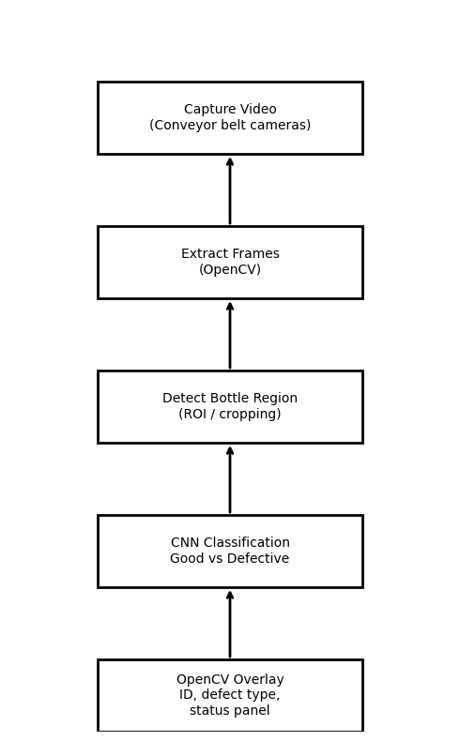
Algorithm + Simulation Flowchart (Part 1)

Slide 4
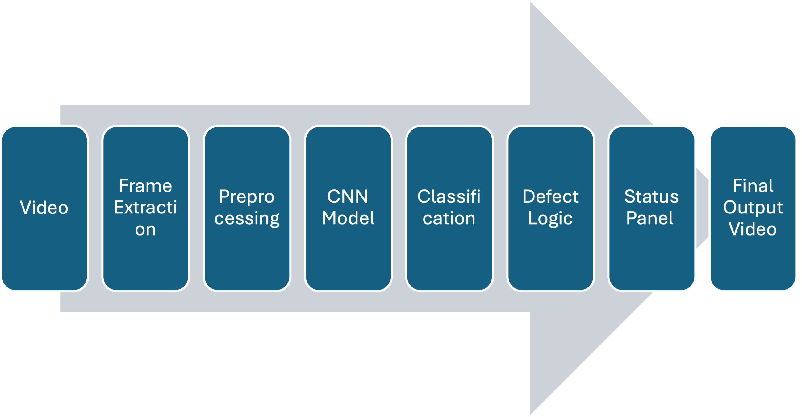
Algorithm + Simulation Flowchart (Part 2)
Video
Frame Extraction
Preprocessing
CNN Model
Classification
Defect Logic
Status Panel
Final Output Video
Modules:
·TensorFlow / Keras (CNN)
·OpenCV (frame processing & drawing)
·Simple NLP text parsing to map
·defect labels to readable messages

Slide 5
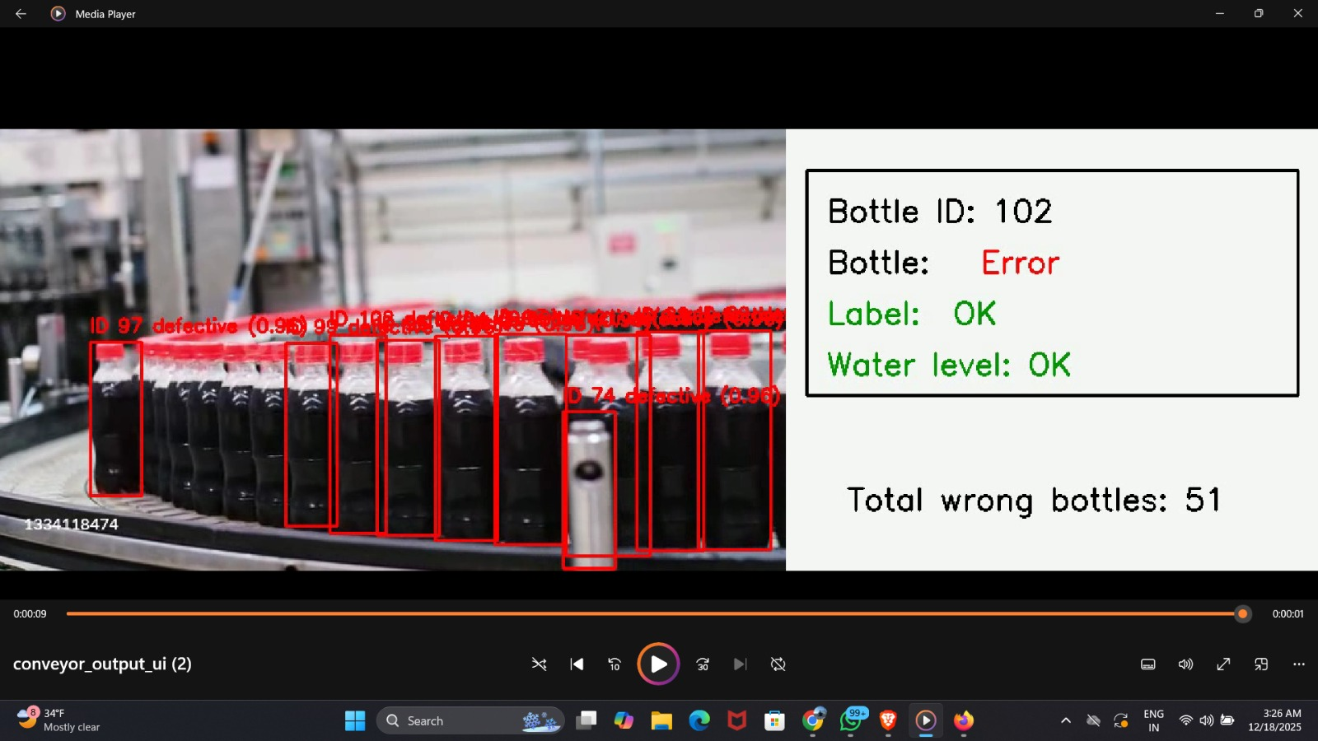
Outputs & Results
Outputs:
·Annotated conveyor-belt video showing bottle IDs
·Red bounding boxes for defective
·Blue bounding boxes for normal
Evaluation Metrics:
·Model accuracy ≈ 90–92%
·Precision & recall for defect detection
·Real-time processing: ~15–20 FPS
Visual Results:
·Confidence score displayed (0–1)
·“Total wrong bottles” counter

Slide 6
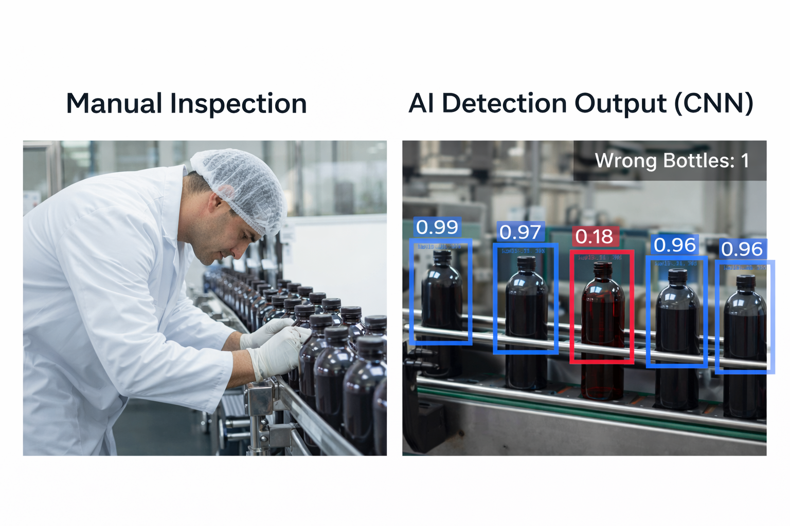
Comparison
Standard Industry Method:
·Manual inspection
·Basic threshold-based image analysis
Our System:
·CNN-based classification
·Multi-defect logic (shape + label + fill)
Reference Paper Benchmark:
·CNN-based bottle inspection — ~90% accuracy
·Our model — comparable performance in small dataset conditions
Advantage:
·Real-time + low cost
·Scalable for industrial use

Slide 7
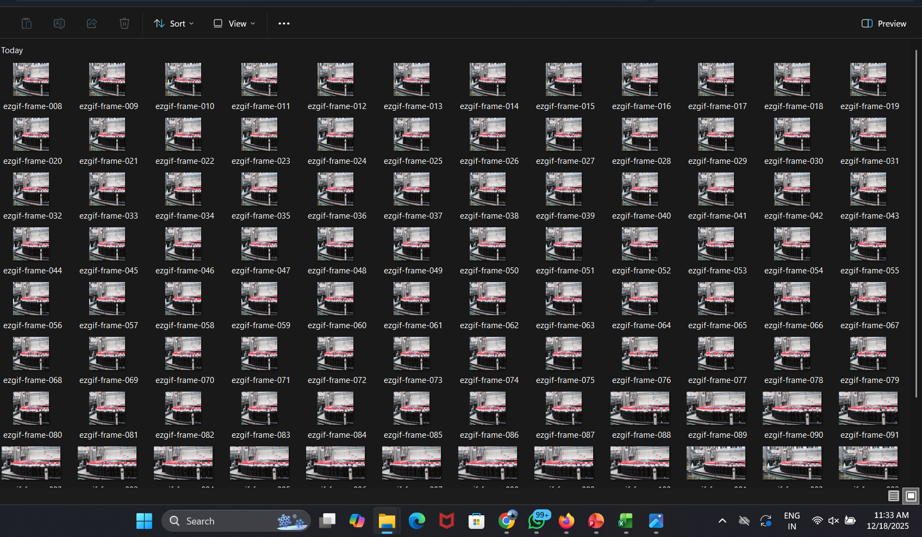
Validation / Proof
Validation Steps:
Tested on mixed frames (good + defective)
Multiple conveyor speeds
Accuracy measured per frame
Visual review + counter validation
Why reliable:
Multiple datasets
Frame-by-frame verification
Confidence thresholding

Slide 8
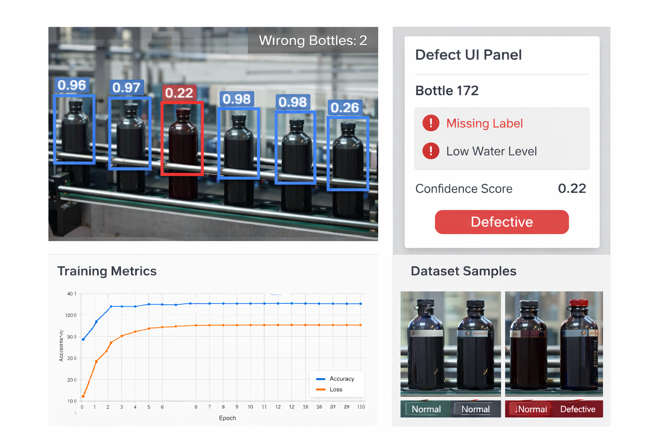
Discussion, Tangible Outputs & Gaps
Working Deliverables:
·Trained CNN model
·Automated detection video
·Defect UI panel for each bottle
·Wrong bottle counter
Limitations:
·Dataset small
·No advanced object tracking
·Cannot detect all defect types
Future Work:
·YOLO-based detection for bottle segmentation
·Larger dataset
·Multi-camera analysis
·Integration with PLC for rejection gate

Slide 9
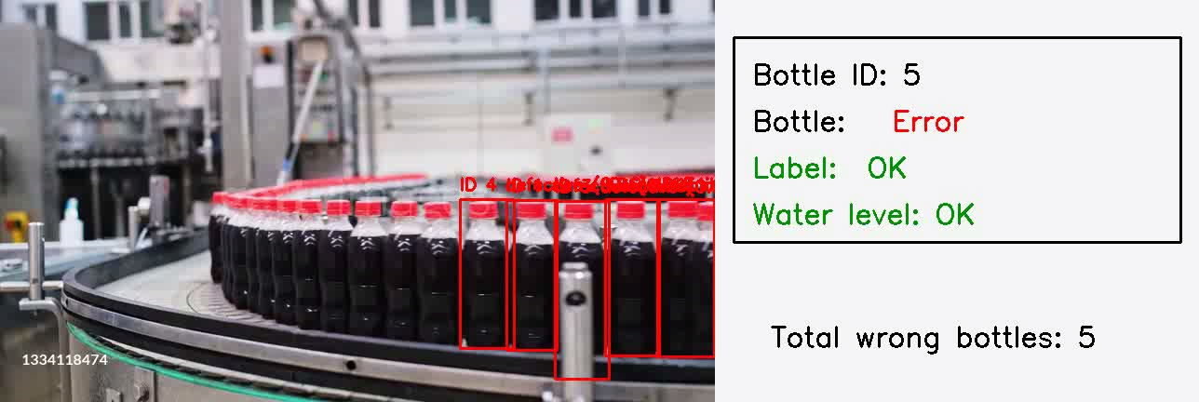
Demo video

Slide 10
Thank You

